Slide 1

“An Overview of Research Papers Analysis Regarding Road Scene Analysis”
Supervisor : MD Tamim Hossain
Presented By : Sourina Dutta Oishi

Slide 2

Studied Papers & Identified Categories
Scene Perception
&
Object Detection
Human Behavior Analysis
Data Resources
&
Geographical Adaptation
Rule Enforcement &
ViolationDetection
2

Slide 3
Identified Patterns
Real-time Vehicle & Pedestrian Detection
Traffic Violation & Driver Behavior Analysis
Urban Scene Understanding & Dataset Utility
Explainable & Adaptive AI Models
Traffic Monitoring & Enforcement Automation
2

Slide 4
Category 1: Scene Perception & Object Detection
Key Insights and Findings:
Real-time detection of vehicles, pedestrians, and motorbikes using deep learning (YOLO/CNN) and sensor fusion (camera + LiDAR + radar).
Multi-object tracking enables accurate environment mapping, even in dense urban traffic.
Robust detection techniques handle occlusions, overlaps, and chaotic traffic scenarios.
Enables foundation for autonomous traffic monitoring and AI traffic systems.
2
3

Slide 5
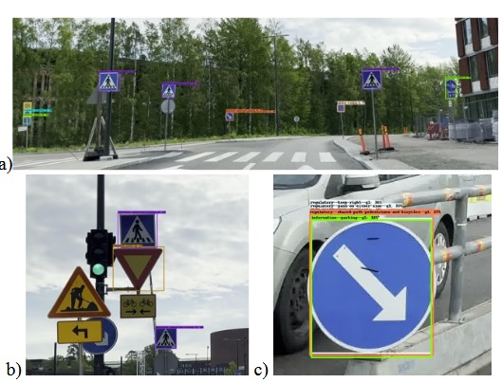
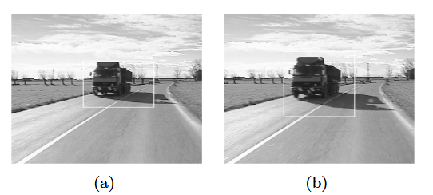
Example & Findings (Category 1) :
Example Outputs:
Real-time detection of vehicles, pedestrians, and motorbikes using YOLO/CNN and sensor fusion (camera + LiDAR + radar).
Multi-object tracking ensures accurate mapping in dense urban traffic.
Robust detection handles occlusions, overlaps, and chaotic environments.
System output examples: Object detection for sequence(a) and close-up examples (b, c)
(a,b) Vehicle detection on the road sequence

Slide 6
Conclusion
Enables accurate real-time detection and tracking of vehicles, pedestrians, and motorbikes. Forms the foundation for AI-based traffic monitoring.
Implementation:
Provides the foundation for real-time road scene analysis using camera/LiDAR/radar data.
Enables accurate detection of vehicles, pedestrians, and motorbikes for monitoring traffic flow.
Forms the basis for AI traffic surveillance systems and autonomous monitoring.
2
3

Slide 7
Category 2: Human Behavior Analysis
Key Insights and Findings:
Pedestrian behavior modeling improves crossing prediction and collision avoidance.
Use of neural-symbolic/fuzzy approaches provides explainable and interpretable predictions.
Predicts driver/rider behaviors such as lane changes, rash driving, and risky maneuvers.
Behavioral datasets (e.g., CS-MRBD) allow training models for chaotic traffic environments.
2
3

Slide 8
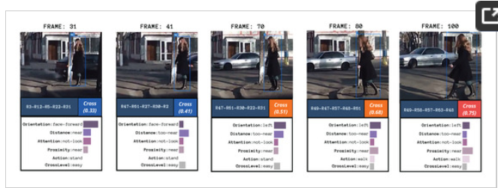
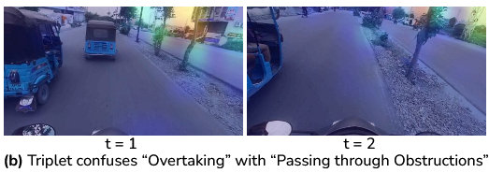
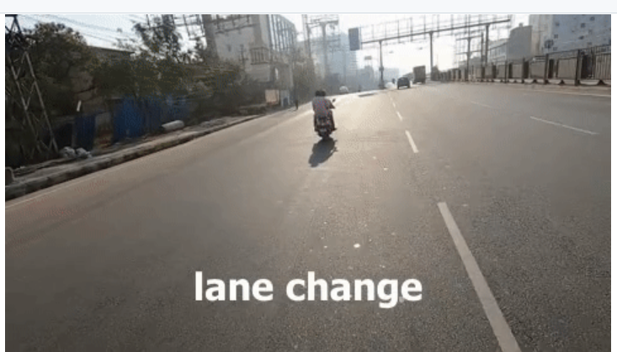
Example & Findings (Category 2) :
Example Outputs:
Predicts driver/rider behaviors: lane changes, rash driving, risky maneuvers.
Models pedestrian crossing and movement patterns for safety.
Explainable AI (neural + symbolic/fuzzy) enables interpretable behavior prediction.
***System output examples: a)Pedestrian crossing behavior,
b) Overtaking with passing through Obstructions,
c) lane change,

Slide 9
Conclusion:
Predicts driver, rider, and pedestrian behaviors to enhance road safety. Supports proactive interventions in risky traffic scenarios.
Implementation:
Predicts risky driver and rider behaviors for proactive safety measures.
Pedestrian movement modeling supports collision avoidance and crowd management.
Explainable AI ensures trustworthy predictions for decision-making in enforcement systems.
2
3

Slide 10
Category 3: Data Resources & Geographical Adaptation
Key Insights and Findings:
Multi-object urban datasets with annotations for vehicles, pedestrians, motorbikes support model training.
Integration of local traffic patterns and geographic context improves model performance.
Dataset curation and feature selection guide adaptation to specific urban environments.
Sensor fusion and mapping techniques enable scalable scene understanding across regions.
2
3

Slide 11
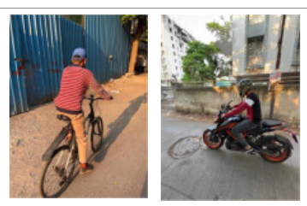
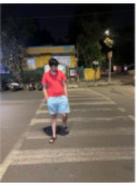
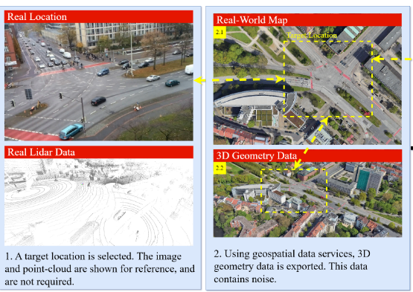
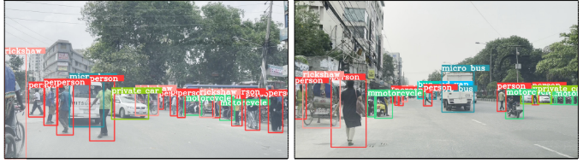
Example & Findings (Category 3) :
Example Outputs:
Multi-object urban datasets provide annotated vehicles, pedestrians, motorbikes for training.
Local traffic patterns and geographic context improve model performance.
Data curation supports adaptation to chaotic urban environments.
***System output examples: a) multi-objects,
b) Systematic Method to Model High-Fidelity Digital Twin for Real-World Locations,
c) Images are captured from the driving perspective of diverse road scenes, objects from
different viewpoints

Slide 12
Conclusion:
Provides annotated datasets and local traffic adaptation for effective model training. Ensures scalable deployment across urban environments.
Implementation:
Ready-to-use urban datasets accelerate model training and testing.
Geographic adaptation improves local traffic condition understanding.
Multi-sensor and multi-object data allow scalable deployment across different cities.
2
3

Slide 13
Category 4: Rule Enforcement & Violation Detection
Key Insights and Findings:
Automated license plate recognition and traffic violation detection reduces manual policing effort.
Detection of red-light violations, illegal lane changes, blocks the padestrian lane and reckless driving using video feeds.
Genetic algorithms and optimization techniques improve detection efficiency and system reliability.
Forms the backbone for AI-based traffic police and automated enforcement systems.
2
3

Slide 14
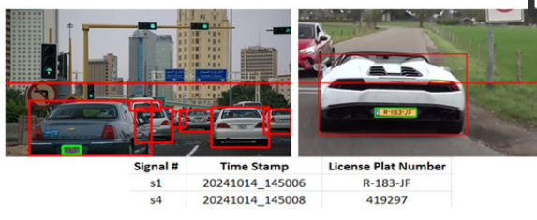
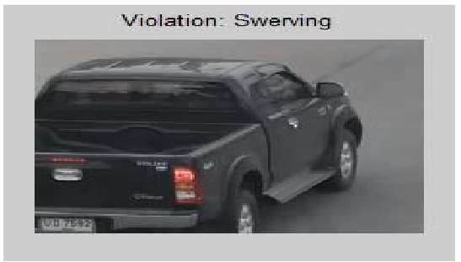
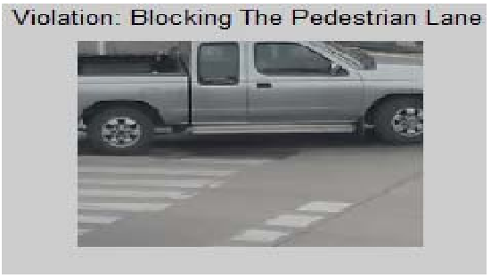
Example & Findings (Category 4) :
Example Outputs:
Automated license plate recognition and violation detection reduces manual effort.
Detects red-light violations, illegal lane changes, and reckless driving.
Optimization methods (e.g., genetic algorithms) improve detection efficiency and reliability.
***System output examples:
a)License plate recognition,
b) Violation: Swerving,
c) Violation: Blocking the pedestrian lane

Slide 15
Conclusion:
Automates detection of traffic violations, reducing manual effort. Forms the backbone of AI traffic police and enforcement systems.
Implementation:
Automates license plate recognition and traffic violation detection, reducing manual effort.
Supports AI traffic police systems to detect red-light violations, illegal lane changes, and reckless driving.
Optimization techniques improve system efficiency, reliability, and real-time response.
2
3

Slide 16
THANK
YOU
PREMIERE UNIVERSITY

